Slide 1
Mid-Coast Water Planning Partnership Next Steps
Alexandria Scott
Partnership Planning Coordinator

Slide 2
9/28 Survey Results & Proposed Changes to the Draft Plan
Appendix H
What the Charter Signatories asked for was to point to the nexus between federal policies (Clean Water Act, Safe Water Drinking Act, ESA) & the local plan.
Remove the Appendix. Point to other sources of information where this information is contained (Step 2 Reports, IWRS, ect). Include 1-2 paragraphs in the plan for this.
Action 45
Riparian Restoration; Restore Channels; Floodplain Reconnection; Restore Stream Flow: Use established methods (e.g., field assessment, remote sensing, and physical models, such as Heat Source) and local knowledge to prioritize stream reaches for riparian buffer restoration projects Support efforts to Advocate for increaseng wooded buffer zones on priority streams. associated with intermittent and non-fish bearing streams that feed source water as well as perennial streams that are not currently regulated (e.g., rural residential, urban, legacy agricultural areas).

Slide 3
9/28 Survey Results & Proposed Changes to the Draft Plan
Action 46
Riparian Restoration; Restore Channels: Advocate for the restoration and conservation of native riparian vegetation to facilitate large natural wood recruitment, maintain water quality, ensure ecological function, and produce habitat for aquatic species, including beavers.
Desired Outcome
Native riparian vegetation is restored and conserved to support and enhance ecological function in the region. Woody buffer zones associated with all stream sizes, including intermittent and non-fish bearing streams, are increased. Riparian zones, including intermittent flow stream zones, are expanded and/or restored, to levels that provide adequate ecological functions.

Slide 4
9/28 Survey Results & Proposed Changes to the Draft Plan
Action 47
Watershed Function and Ecosystem Services: Encourage longer forest rotations and Implement more erosion control practices.
Desired Outcome
Reduced sediment delivery to regional streams. Private forests are managed for multiple benefits, including ecological function and values (i.e., mimic natural watershed hydrology, sediment and nutrient processes and carbon storage). Larger proportion of road network is hydrologically disconnected from streams. Private landowners forest operations widely implement Oregon Plan voluntary measures and report project data to the Oregon Watershed Restoration Inventory (OWRI) 38 or other databases, to track improvements.
Participants
Participants: public and private landowners, Lincoln County, Oregon Department of Transportation, Oregon Department of Agriculture, US Forest Service, Bureau of Land Management, private landowners, private industrial forestry, Oregon Department of Forestry, private small woodland landowners Watershed councils, Lincoln Soil and Water Conservation District, Oregon Department of Environmental Quality, Oregon Water Resources Department, Oregon Department of Fish and Wildlife

Slide 5
Next Step: Eligible Charter Signatories Reach Consensus on Submitting Plan for State Recognition
Partnership Planning Coordinator will post this latest iteration of the plan by the end of day tomorrow, you have 3-weeks to complete the consensus check now that we have a complete draft for you to look at
Red, Yellow, Green cards
Green card -- indicates agreement with the plan moving forward to state recognition.
Yellow card -- indicates some hesitation or caution about the plan moving forward to state recognition and a desire to discuss (be specific).
Red card -- indicates disagreement with a specific item in the plan moving forward to state recognition and propose a productive alternative. We will not be revising anything from Steps 1, 2 or 3 consensus has already been reached on those items. We will not be adding anything more to the implementation table. Keep in mind these need to be things that you cannot support moving forward in the plan, we are past the point of wordsmithing the entire document.

Slide 6
Reminder of Consensus Decision Making Process According to MC-WPP Charter
While anyone may participate in meetings and deliberations of the Partnership or any working groups that have been established, only persons signing the Charter may participate in Partnership decision making.
Partnership members (and/or their alternates) must have attended at least two of the last four meetings to formally participate in making decisions.
Each entity represented in the Partnership has one ‘voice’. If there are multiple individuals representing an entity, they must select one person amongst them to speak on behalf of the entity.
If Consensus is not reached (Option 2 in timeline on slide 8):
Provide opportunity for dissenting members to provide constructive alternatives to meet everyone’s needs at sub-group meeting; then report back to Partnership at a subsequent meeting and re-test for consensus.
Refer to Coordinating Committee to determine how to handle the issue. They may table, study further, narrow options, or select a preferred option to recommend to the Partnership.
If consensus is still not reached, a decision may still be reached by agreement of the majority of the Partnership and recorded as such.

Slide 7
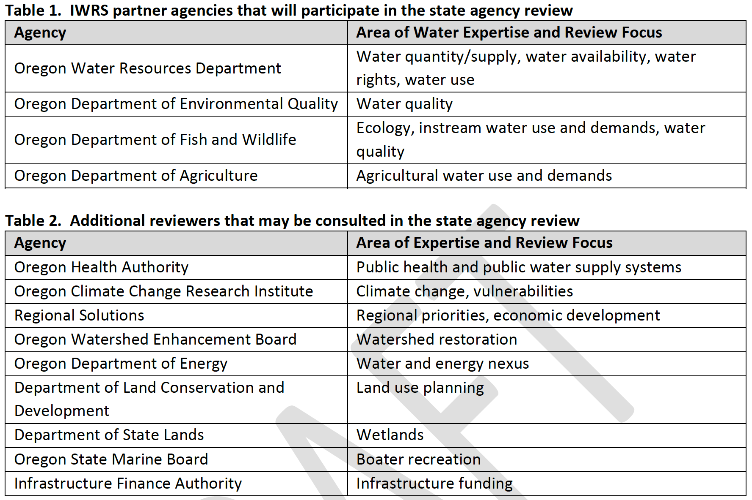
What is Next? State Agency Review
The primary purpose of the state agency review is to make a recommendation to the Commission as to whether a Plan was developed in a manner consistent with the 2015 Draft Guidelines and statewide IWRS principles and should be recognized by the Commission

Slide 8
2021 – 2022 Schedule To Achieve State Recognized Plan
C.S. meeting to review & incorporate survey feedback
Option 1: Submit the Plan for State Agency Review & Public Review
State Agency Review (60-days) & Public Review (30-days)
Partnership Meeting to Review Outcomes of Public Review & Sate Agency Review
Results of the consensus check are shared in a webinar
Nov 18th, 2021
Week of Dec 13th-17th, 20221
Week of Dec 20th-24th
March 2022 (depends on which option is pursued)
3-weeks for eligible Charter Signatories to review the full draft plan & submit consensus check (due by COB on 12/10/21)
Discussion for yellow or red card submission & Identify solutions
Partners identify plan adoption processes for their organization to prepare for implementation
Partners discuss outcomes & incorporate necessary edits for state recognition
Option 2: Submit the Plan for State Agency Review & Public Review
Partners reach consensus on the outcomes of discussion & incorporate edits to get yellow & red cards to green
Option 2: Subsequent meeting if consensus not reached the week of Dec 13-17
Begin to form Water Action Teams, talk about Partnership support & structure
If consensus is reached, conveners submit to be put on a Water Resource Commission agenda to present the plan for state recognition in May
Week of Jan 3rd-7th, 2022
Week of Jan 10th -14th, 2022
Charter Signatories reach consensus on the draft plan being submitted for public review & state agency review
Partners Sign Declaration of Cooperation or Resolution for Implementation now that plan is complete
Discussion for yellow or red card submission & Identify solutions
If consensus not reached move to alternative listed in Charter

Slide 9
After the State Agency Review Outcomes Have Been Discussed & Incorporated: Resource Commission Recognition
If a planning group would like the Commission to formally recognize the Final Plan, the process will follow these steps:
1. State agency review results in a recommendation that the Final Draft Plan be recognized;
2. Planning Group adopts a Final Plan;
3. Convener(s) work with Planning Coordinators to request time on a regular Commission agenda;
4. Public notification of the Final Plan on the Commission agenda;
5. Posting of Final Plan, staff report and PowerPoint on OWRD’s website;
6. Convener(s) present Final Plan to the Commission;
7. Public comments to the Commission at the meeting; and
8. Commission discussion, motion and decision.
The Commission will make a decision after considering the following factors:
1. The Convener(s) presentation of the Final Plan;
2. The state agency review team recommendation;
3. The Commissioners’ review of the Final Plan;
4. Letters of support from partners, state agencies and others; and
5. Public comments received prior to or during the Commission meeting.

Slide 10
After That We Are on to Implementation! Yay!

