Slide 1
Mid-Coast Water Planning Partnership
Charter Signatory Meeting
December 15th, 2021
11am-12:30pm

Slide 2
Voting to Reach Consensus on Submitting Plan for State Recognition
Signatories were given 3-weeks to complete the consensus check of the draft plan
Parameters for Voting
Green card -- indicates agreement with the plan moving forward to state recognition.
Yellow card -- indicates some hesitation or caution about the plan moving forward to state recognition and a desire to discuss (be specific).
Red card -- indicates disagreement with a specific item in the plan moving forward to state recognition and propose a productive alternative. Keep in mind these need to be things that you cannot support moving forward in the plan, we are past the point of wordsmithing the entire document.

Slide 3
Reminder of Consensus Decision Making Process According to MC-WPP Charter
Anyone may participate in meetings and deliberations of the Partnership, only persons signing the Charter may participate in Partnership decision making.
Partnership members (and/or their alternates) must have attended at least two of the last four meetings to formally participate in making decisions.
Each entity represented in the Partnership has one ‘voice’.
If Consensus is not reached:
Provide opportunity for dissenting members to provide constructive alternatives to meet everyone’s needs at sub-group meeting; then report back to Partnership at a subsequent meeting and re-test for consensus.
Refer to Coordinating Committee to determine how to handle the issue. They may table, study further, narrow options, or select a preferred option to recommend to the Partnership.
If consensus is still not reached, a decision may still be reached by agreement of the majority of the Partnership and recorded as such.

Slide 4
Eligible Signatories
Jennifer Beathe, Starker Forests, Inc (Green)
Jay Macpherson, Oregon Health Authority (Green)
Paul Robertson, Robertson Environmental LLC
Leo Williamson & Matt Thomas, Oregon Department of Forestry (Green)
Geoffrey Wilkie, Interested Citizen
Caylin Barter, Wild Salmon Center
Jeanne Anstine, Newport Community Gardens
David Bayus, Johnson Creek Water Services (Green)
Tim Gross, Civil West Engineering Services Inc.
Alan Fujishin, Gibson Farms (Yellow)
Clare Paul, City of Newport
Billie Jo Smith, Interested Citizen (Green)
Penelope Kaczmarek, Interested Citizen (Green)
Mike Broili, MidCoast Watersheds Council (Green)
Don Andre, Oregon Coast Community forest Association
Suzanne de Szoeke, GSI Water Solutions, Inc.
Mark Saelens, Saelwood LLC (Green)
Jen Hayduk, Lincoln Soil and Water Conservation District
Evan Hayduk, MidCoast Watersheds Council
David Waltz, Oregon Department of Environmental Quality (Green)
Lisa Phipps, Department of Land Conservation and Development (Green)
Adam Denlinger, Seal Rock Water District (Green)
Bill Montgomery, Interested Citizen (Green)
Stan Van De Wetering, Confederated Tribes of Siletz Indians
Joe Moll, McKenzie River Trust (Green)
Jerry Anderson, Manulife Investment Management (Green)
Stephanie Reid, City of Lincoln City (Green)
Cyndi Karp, Ecosystem Advocate (Green)
Steve Parrett, Oregon Water Resources Department (Yellow – still submit for state recognition)

Slide 5
Statistics For This Vote
Out of 29 eligible signatories, 18 participated in this vote
Out of the 18 participants, 2 submitted yellow cards & 16 submitted green cards & there were no red cards

Slide 6
Yellow Card Feedback for Discussion
Oregon Water Resources Department
The plan identifies some user groups such as industrial self-supplied, farmers, and community water systems who are important, but were not able to adequately participate in the planning process. The plan should include an explanation about efforts taken to reach those people, challenges you faced, and how you will try to engage them during future work. This will help the agency review team understand that the plan was developed with a balanced representation of interests, to the extent possible, and that you made a good-faith effort to reach them.
Timeline: 3 phases within a 10-year period involving 59 actions seems unrealistic. We encourage the collaborative to think about implementation over a longer timeline, considering both the priority and sequencing of actions and the funding needed. It’s important to set realistic expectations about implementation, so people don’t feel plan implementation is failing to meet their expectations.

Slide 7
Yellow Card Feedback for Discussion
Oregon Water Resources Department
Action 52: is not quite clear to us, whether it is legal under existing law for OWRD to limit appropriation in the way described, so that action will need more review and discussion.
Some sources of information in the draft plan are not cited, so it is hard to know the validity of that information or if it was the writer’s opinion, etc. Additional citations should be made in a number of places.
The plan should recognize the state’s role and authority for water management. We can provide example language for this.
Department of Land Conservation and Development
Would really like a statement in the introductory piece that says that these actions have not been reviewed under the lens of the statewide planning goals and local land use ordinances. As a result, as actions are initiated, they may either be allowed, modified, or prohibited based upon land use reviews.

Slide 8
Yellow Card Feedback for Discussion
Gibson Farms
Budget Figures: Concerned that the estimates presented do not consider the full range of potential strategies and projects that might be pursued by Partners, or accurately reflect the specified objectives if pursued by either a likely subset or the full range of partners from their respective positions. The imposed "sticker shock" of these estimates as presented may lead readers to dismiss collaborative water action as prohibitively expensive offhand rather than motivate readers to consider how they might cooperate toward addressing achievable portions of the Plan within their means and capacities.
Step 3 Summaries: Proposed edits to pages 30-46 of the draft plan. Was disappointed with how these were summarized in several cases. Edits submitted are to correct some factual inaccuracies presented regarding how water is administered in OR and the Planning Area. Partnership & general audiences will benefit from those changes.
Appendix A. Definitions: Several terms need minor changes to account for all water uses across the Planning Area or could be attributed differently to match specific definitions used by Oregon agencies, definitions that we relied upon when discussing these issues as a Partnership.
Appendix G. Issues Identified but Not Carried Forward: Could be revised to be more respectful as to why those issues are while maintaining the integrity of our prioritization and consensus process, all the while explaining adequately to our reviewers why these were not fully developed in our Implementation Table.

Slide 9
2021 – 2022 Schedule To Achieve State Recognized Plan
C.S. meeting to review & incorporate survey feedback
Option 1: Submit the Plan for State Agency Review & Public Review
State Agency Review (60-days) & Public Review (30-days)
Partnership Meeting to Review Outcomes of Public Review & Sate Agency Review
Results of the consensus check are shared in a webinar
Nov 18th, 2021
December 15th, 2021
Week of Dec 20th-24th
March 2022
3-weeks for eligible Charter Signatories to review the full draft plan & submit consensus check (due12/10/21)
Discussion for yellow or red card submission & Identify solutions
Partners identify plan adoption processes for their organization to prepare for implementation
Partners discuss outcomes & incorporate necessary edits for state recognition
Option 2: Subsequent meeting if consensus not reached Dec 15th
Option 2: Submit the Plan for State Agency Review & Public Review
Partners reach consensus on the outcomes of discussion & incorporate edits to get yellow & red cards to green
Begin to form Water Action Teams, talk about Partnership support & structure
If consensus is reached, conveners submit to be put on a Water Resource Commission agenda to present the plan for state recognition in May
Week of Jan 3rd-7th, 2022
Week of Jan 10th -14th, 2022
Partners Sign Declaration of Cooperation or Resolution for Implementation now that plan is complete
Charter Signatories reach consensus on the draft plan being submitted for public review & state agency review
Discussion for yellow or red card submission & Identify solutions
If consensus not reached move to alternative listed in Charter

Slide 10
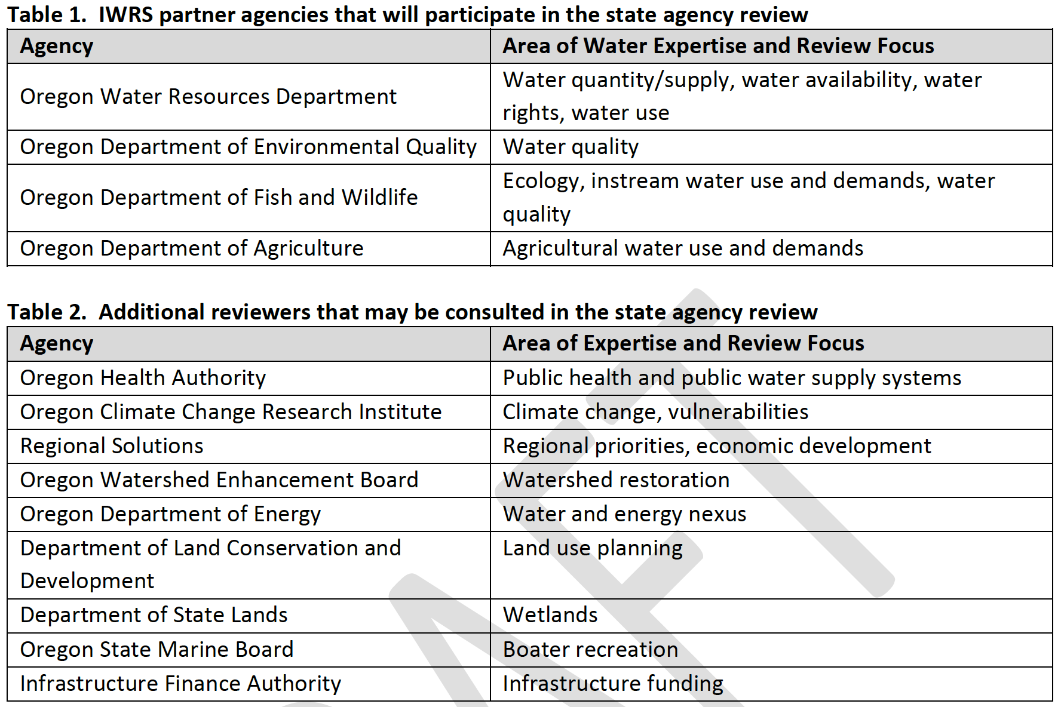
What is Next? State Agency Review
The primary purpose of the state agency review is to make a recommendation to the Commission as to whether a Plan was developed in a manner consistent with the 2015 Draft Guidelines and statewide IWRS principles and should be recognized by the Commission

Slide 11
What The Partnership Will Be Doing While Reviews Take Place
Local adoption processes for the Mid-Coast Water Action Plan
Starting to assemble Water Action Plan Teams
Identify projects already being considered/pursued by Partners in 2022-2024 to help with first 2-year work plan
Agree on how the plan can be used and referenced by Partners
Identify the support that the Partnership can provide in implementation

Slide 12
After the State Agency Review Outcomes Have Been Discussed & Incorporated: Resource Commission Recognition
If a planning group would like the Commission to formally recognize the Final Plan, the process will follow these steps:
1. State agency review results in a recommendation that the Final Draft Plan be recognized;
2. Planning Group adopts a Final Plan;
3. Convener(s) work with Planning Coordinators to request time on a regular Commission agenda;
4. Public notification of the Final Plan on the Commission agenda;
5. Posting of Final Plan, staff report and PowerPoint on OWRD’s website;
6. Convener(s) present Final Plan to the Commission;
7. Public comments to the Commission at the meeting; and
8. Commission discussion, motion and decision.
The Commission will make a decision after considering the following factors:
1. The Convener(s) presentation of the Final Plan;
2. The state agency review team recommendation;
3. The Commissioners’ review of the Final Plan;
4. Letters of support from partners, state agencies and others; and
5. Public comments received prior to or during the Commission meeting.

